Slide 1
Data Mining:
Concepts and Techniques
(3rd ed.)
MODULE 2

Slide 2
Chapter 2: Data Preprocessing
Data Preprocessing
  Types of data?
Data Preprocessing: An Overview
  Data Quality
  Major Tasks in Data Preprocessing
Data Cleaning
Data Integration
Data Reduction
Data Transformation and Data Discretization
Similarity and Dissimilarity measures.

Slide 3

What is Data?
Attributes
Collection of data objects and their attributes
An attribute is a property or characteristic of an object
  Examples: eye color of a person, temperature, etc.
  Attribute is also known as variable, field, characteristic, or feature
A collection of attributes describe an object
  Object is also known as record, point, case, sample, entity, or instance
Objects

Slide 4
Types of attributes ….
Nominal:
  items differentiated by a simple naming system
  They may have numbers assigned to them. But, they are not actual numbers. They simply capture and reference.
  They are ‘categorical’ i.e, they belong to a definable category.
  Ex:- ID numbers, eye color, zip codes

Slide 5
Types of attributes…
2) Ordinal:
  They have some kind of order by their position on the scale.
  order of items can be defined by assigning numbers – relative position.
  letters can also be assigned.
  they are ‘categorical’
  cannot do arithmetic – only ordering property.
  Ex:
    rankings (taste of potato chips on a scale from 1 – 10)
    Grades in {A, B, C, D, E}
    Height in {small, medium, large}

Slide 6
Types of attributes ….
3) Interval:
    Is measured along a scale in which each position is
    equidistant from one another.
    Distance between two pairs will be equivalent in some way.
    Cannot be multiplied, or divided.
    Ex:
    Calendar dates
    Temperature in celsius/fah

Slide 7
Types of attributes….
4) Ratio
numbers can be compared as multiples of one another.
One person can be twice as tall as another person
Number zero has no meaning
Ex:
Difference between a person of age 35 and a person of age 38 is same as difference between people who are 12 and 15. ( 35 to 38 = 3 , 12 to 15 = 3) 3:3 .
Ratio data can be multiplied and divided.

Slide 8
Types of attributes…
Interval and ratio data measure quantities and hence are quantitative.
Ex: length, time, count

Slide 9
Types of attributes…
Nominal (symbolic, categorical)
  Values from an unordered set
  Ex: {red, yellow, blue, ….}
Ordinal :
  Values from an ordered set
  Ex: {good, better, best}
Continuous : real numbers
  Ex: {-9.8, 3.9,…..}

Slide 10
Discrete and Continuous Attributes
Depending on the number of values :-
Discrete Attribute
  Has only a finite or countably infinite set of values
  Examples: zip codes, counts, or the set of words in a collection of documents
  Often represented as integer variables.
  Note: binary attributes are a special case of discrete attributes
Continuous Attribute
  Has real numbers as attribute values
  Examples: temperature, height, or weight.
  Practically, real values can only be measured and represented using a finite number of digits.
  Continuous attributes are typically represented as floating-point variables.

Slide 11


Types of Attributes Summary
There are different types of attributes
  Nominal
    Examples: ID numbers, eye color, zip codes
  Ordinal
    Examples: rankings (e.g., taste of potato chips on a scale from 1-10), grades, height in {tall, medium, short}
  Interval
    Examples: calendar dates, temperatures in Celsius or Fahrenheit.
  Ratio
    Examples: temperature in Kelvin, length, time, counts

Slide 12
Properties of Attribute Values
The type of an attribute depends on which of the following properties it possesses:
  Distinctness: = ≠
  Order: < >
  Addition: + -
  Multiplication: * /
  Nominal attribute: distinctness
  Ordinal attribute: distinctness & order
  Interval attribute: distinctness, order & addition
  Ratio attribute: all 4 properties

Slide 13
Types of Attributes Summary
Classify the following attributes as :-
binary, discrete or continuous
Qualitative(nominal or ordinal) or quantitative (interval or ratio)
Age in years
  Ans: discrete, quantitative, ratio
2) Brightness as measured by a light meter
  Ans: continuous, quantitative, ratio
3) Bronze, silver and gold medals as awarded at Olympics
  Ans: Discrete, qualitative, ordinal.

Slide 14
Types of data sets
Record
  Data Matrix
  Document Data
  Transaction Data
Graph
  World Wide Web
  Molecular Structures
Ordered
  Spatial Data
  Temporal Data
  Sequential Data
  Genetic Sequence Data

Slide 15
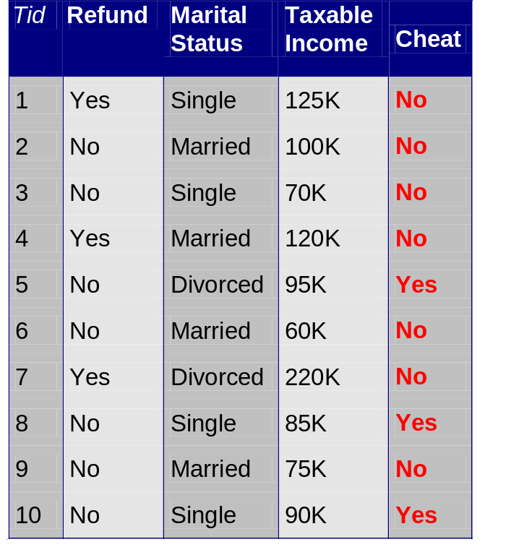
Record Data
Data that consists of a collection of records, each of which consists of a fixed set of attributes

Slide 16
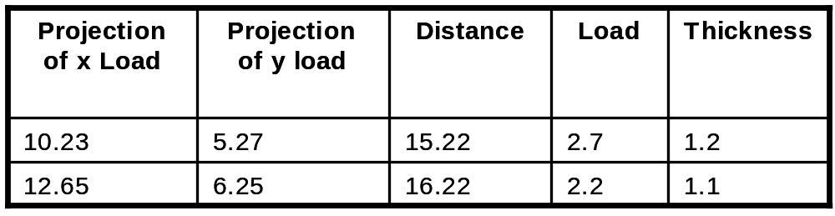
Data Matrix
If data objects have the same fixed set of numeric attributes, then the data objects can be thought of as points in a multi-dimensional space, where each dimension represents a distinct attribute
Such data set can be represented by an m by n matrix, where there are m rows, one for each object, and n columns, one for each attribute

Slide 17
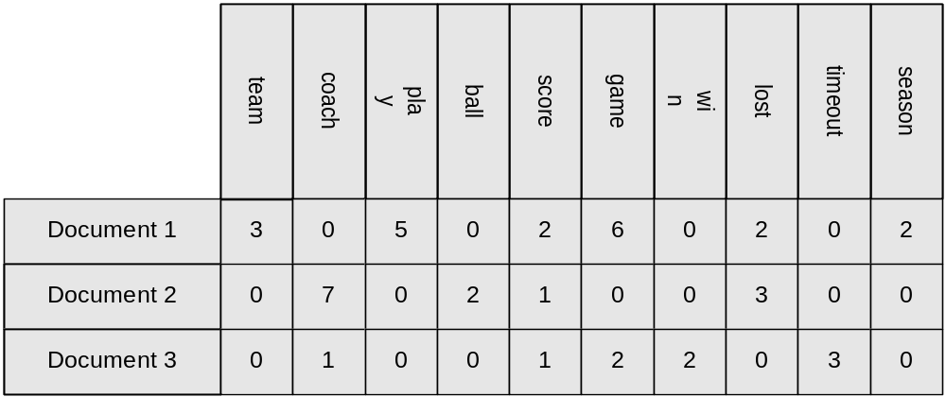
Document Data
Each document becomes a `term' vector,
  each term is a component (attribute) of the vector,
  the value of each component is the number of times the corresponding term occurs in the document.

Slide 18

Transaction Data
A special type of record data, where
  each record (transaction) involves a set of items.
  For example, consider a grocery store. The set of products purchased by a customer during one shopping trip constitute a transaction, while the individual products that were purchased are the items.

Slide 19
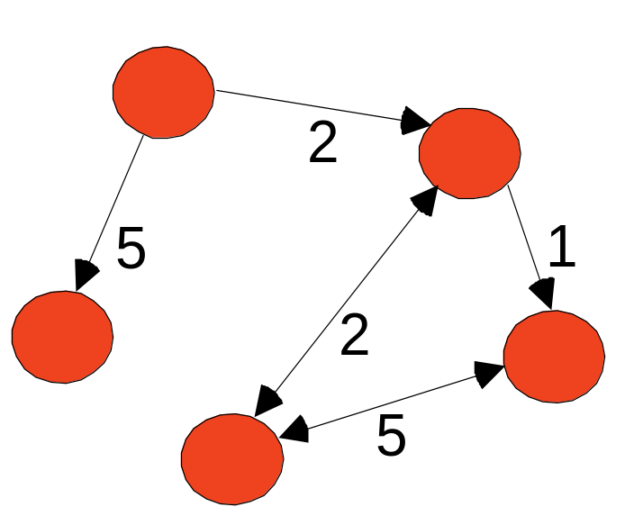
Graph Data
Examples: Generic graph and HTML Links
a graph is sometimes a more
convenient and powerful representation of data
can be used to capture relationship between data objects.
Data objects themselves can be graphs.
Ex: set of linked web pages can be represented as graphs

Slide 20
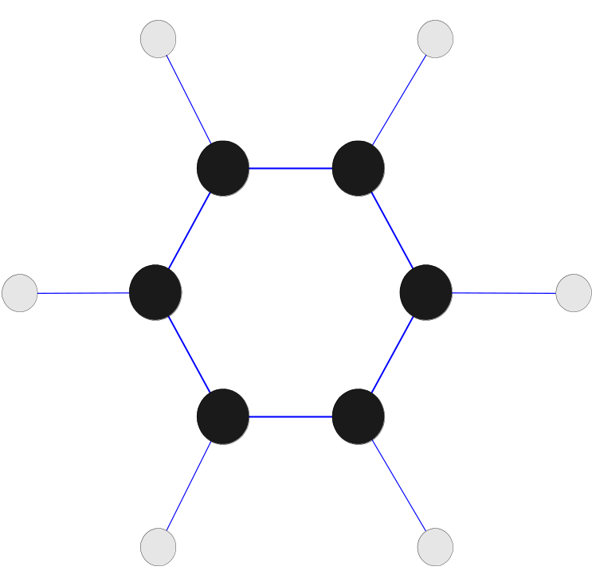
Chemical Data as a Graph
Data with objects that are graphs:-
Objects have sub-objects that have relationships
Ex : structure of chemical compounds
Nodes – atoms
Links – chemical compounds
Benzene Molecule: C₆H₆
Mining Substructures
Which substructures occur frequently
in a chemical compound?
Is the presence of any substructure
associated with any other?

Slide 21
Ordered Data
Attributes have relationships that involve order in time/space
Extension of a record data
Each record has a time associated with it
Each attribute can also be given a time stamp.

Slide 22
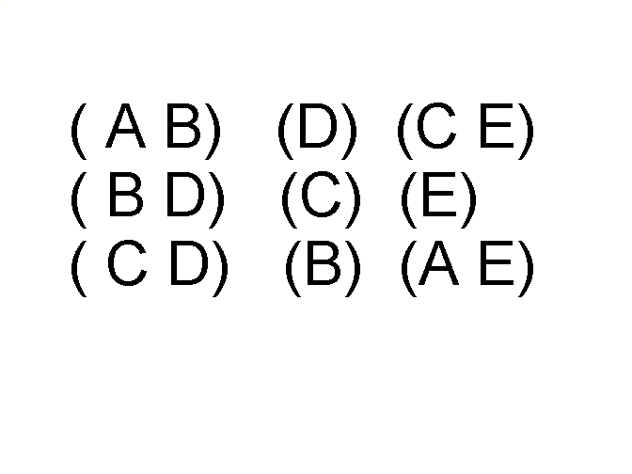
Ordered Data
Sequences of transactions
Items/Events
Patterns ?
People who buy DVD player tend to buy DVDs in the period immediately following the purchase of DVD player.
An element of the sequence

Slide 23
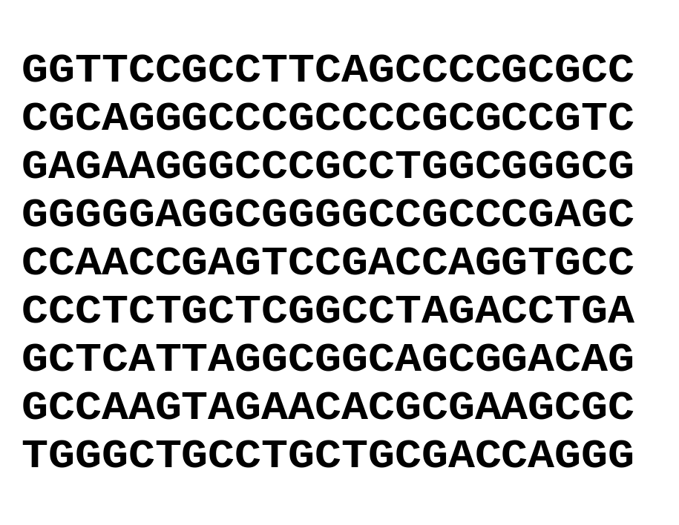
Ordered Data
Genomic sequence data – sequences of individual entities, letters/words. No time stamp
Ex: genetic info of animals/plants in the form of sequences of genes/nucleotides.
Human genetic code sequence- 4 genes : A, T, G and C.
Mining on gene data – capture structure and properties of genes
Mining biological sequence data - BIOINFORMATICS

Slide 24
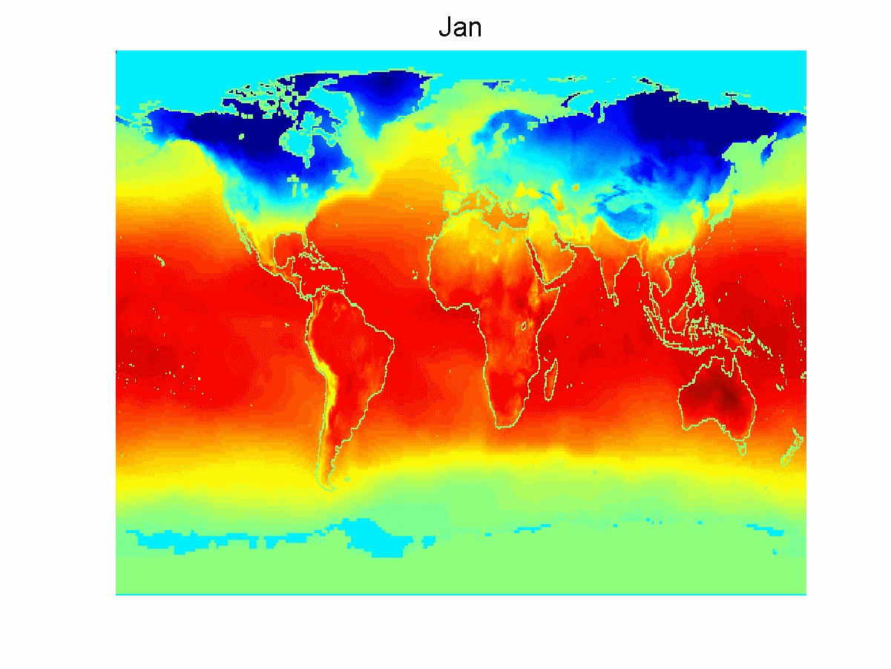
Ordered Data
Spatio-Temporal
Data
Spatial attributes
– position and area
Ex: weather data
Earth sciences data
- measures temp
and pressure
measured at points
on latitude - longitude
Average Monthly Temperature of land and ocean

Slide 25
Time-series data
A special type of sequential data
Each record is a time-series i.e. a series of measurements taken over time
Ex: financial data set has objects which are the time series of the daily prices of various stocks.
Have temporal autocorrelation
If two measurements are close in time, then their values are often similar.

Slide 26
Chapter 2: Data Preprocessing
Data Preprocessing
  Types of data?
Data Preprocessing
  Data Quality
  Major Tasks in Data Preprocessing
Data Cleaning
Data Integration
Data Reduction
Data Transformation and Data Discretization
Similarity and Dissimilarity measures.

Slide 27
Data Quality: Why Preprocess the Data?
Measures for data quality: A multidimensional view
  Accuracy: correct or wrong, accurate or not
  Completeness: not recorded, unavailable, …
  Consistency: some modified but some not, dangling, …
  Timeliness: timely update?
  Believability: how trustable the data are correct?
  Interpretability: how easily the data can be understood?

Slide 28
Major Tasks in Data Preprocessing
Data cleaning
  Fill in missing values, smooth noisy data, identify or remove outliers, and resolve inconsistencies
Data integration
  Integration of multiple databases, data cubes, or files
Data reduction
  Dimensionality reduction
  Numerosity reduction
  Data compression
Data transformation and data discretization
  Normalization
  Concept hierarchy generation

Slide 29
Chapter 2: Data Preprocessing
Data Preprocessing
  Types of data?
Data Preprocessing: An Overview
  Data Quality
  Major Tasks in Data Preprocessing
Data Cleaning
Data Integration
Data Reduction
Data Transformation and Data Discretization
Similarity and Dissimilarity measures.

Slide 30
Data Cleaning
Data in the Real World Is Dirty: Lots of potentially incorrect data, e.g., instrument faulty, human or computer error, transmission error
  incomplete: lacking attribute values, lacking certain attributes of interest, or containing only aggregate data
    e.g., Occupation=“ ” (missing data)
  noisy: containing noise, errors, or outliers
    e.g., Salary=“−10” (an error)
  inconsistent: containing discrepancies in codes or names, e.g.,
    Age=“42”, Birthday=“03/07/2010”
    Was rating “1, 2, 3”, now rating “A, B, C”
    discrepancy between duplicate records
  Intentional (e.g., disguised missing data)
    Jan. 1 as everyone’s birthday?

Slide 31
Incomplete (Missing) Data
Data is not always available
  E.g., many tuples have no recorded value for several attributes, such as customer income in sales data
Missing data may be due to
  equipment malfunction
  inconsistent with other recorded data and thus deleted
  data not entered due to misunderstanding
  certain data may not be considered important at the time of entry
  not register history or changes of the data
Missing data may need to be inferred

Slide 32
How to Handle Missing Data?
Ignore the tuple: usually done when class label is missing (when doing classification)—not effective when the % of missing values per attribute varies considerably
Fill in the missing value manually: tedious + infeasible?
Fill in it automatically with
  a global constant : e.g., “unknown”, a new class?!
  the attribute mean
  the attribute mean for all samples belonging to the same class: smarter
  the most probable value: inference-based such as Bayesian formula or decision tree

Slide 33
Noisy Data
Noise: random error or variance in a measured variable
Incorrect attribute values may be due to
  faulty data collection instruments
  data entry problems
  data transmission problems
  technology limitation
  inconsistency in naming convention
Other data problems which require data cleaning
  duplicate records
  incomplete data
  inconsistent data

Slide 34
How to Handle Noisy Data?
Binning
  first sort data and partition into (equal-frequency) bins
  then one can smooth by bin means, smooth by bin median, smooth by bin boundaries, etc.
Regression
  smooth by fitting the data into regression functions
Clustering
  detect and remove outliers
Combined computer and human inspection
  detect suspicious values and check by human (e.g., deal with possible outliers)

Slide 35
Data Cleaning as a Process
Data discrepancy detection
  Use metadata (e.g., domain, range, dependency, distribution)
  Check field overloading
  Check uniqueness rule, consecutive rule and null rule
  Use commercial tools
    Data scrubbing: use simple domain knowledge (e.g., postal code, spell-check) to detect errors and make corrections
    Data auditing: by analyzing data to discover rules and relationship to detect violators (e.g., correlation and clustering to find outliers)
Data migration and integration
  Data migration tools: allow transformations to be specified
  ETL (Extraction/Transformation/Loading) tools: allow users to specify transformations through a graphical user interface
Integration of the two processes
  Iterative and interactive (e.g., Potter’s Wheels)

Slide 36
Chapter 3: Data Preprocessing
Data Preprocessing
  Types of data?
Data Preprocessing
  Data Quality
  Major Tasks in Data Preprocessing
Data Cleaning
Data Integration
Data Reduction
Data Transformation and Data Discretization
Similarity and Dissimilarity measures.

Slide 37
Data Integration
Data integration:
  Combines data from multiple sources into a coherent store
Schema integration: e.g., A.cust-id ≡ B.cust-#
  Integrate metadata from different sources
Entity identification problem:
  Identify real world entities from multiple data sources, e.g., Bill Clinton = William Clinton
Detecting and resolving data value conflicts
  For the same real world entity, attribute values from different sources are different
  Possible reasons: different representations, different scales, e.g., metric vs. British units

Slide 38
Handling Redundancy in Data Integration
Redundant data occur often when integration of multiple databases
  Object identification: The same attribute or object may have different names in different databases
  Derivable data: One attribute may be a “derived” attribute in another table, e.g., annual revenue
Redundant attributes may be able to be detected by correlation analysis and covariance analysis
Careful integration of the data from multiple sources may help reduce/avoid redundancies and inconsistencies and improve mining speed and quality

Slide 39

Correlation Analysis (Nominal Data)
Χ² (chi-square) test
The larger the Χ² value, the more likely the variables are related
The cells that contribute the most to the Χ² value are those whose actual count is very different from the expected count
Correlation does not imply causality
  # of hospitals and # of car-theft in a city are correlated
  Both are causally linked to the third variable: population

Slide 40
Chi-Square Calculation: An Example
Χ² (chi-square) calculation (numbers in parenthesis are expected counts calculated based on the data distribution in the two categories)
It shows that like_science_fiction and play_chess are correlated in the group
 | Play chess | Not play chess | Sum (row)
Like science fiction | 250(90) | 200(360) | 450
Not like science fiction | 50(210) | 1000(840) | 1050
Sum(col.) | 300 | 1200 | 1500

Slide 41



Correlation Analysis (Numeric Data)
Correlation coefficient (also called Pearson’s product moment coefficient)
  where n is the number of tuples, and are the respective means of A and B, σ_{A} and σ_{B} are the respective standard deviation of A and B, and Σ(a_{i}b_{i}) is the sum of the AB cross-product.
If r_{A,B} > 0, A and B are positively correlated (A’s values increase as B’s). The higher, the stronger correlation.
r_{A,B} = 0: independent; r_{AB} < 0: negatively correlated

Slide 42

Visually Evaluating Correlation
Scatter plots showing the similarity from –1 to 1.

Slide 43



Correlation (viewed as linear relationship)
Correlation measures the linear relationship between objects
To compute correlation, we standardize data objects, A and B, and then take their dot product

Slide 44


Covariance (Numeric Data)
Covariance is similar to correlation
  where n is the number of tuples, and are the respective mean or expected values of A and B, σ_{A} and σ_{B} are the respective standard deviation of A and B.
Positive covariance: If Cov_{A,B} > 0, then A and B both tend to be larger than their expected values.
Negative covariance: If Cov_{A,B} < 0 then if A is larger than its expected value, B is likely to be smaller than its expected value.
Independence: Cov_{A,B} = 0 but the converse is not true:
  Some pairs of random variables may have a covariance of 0 but are not independent. Only under some additional assumptions (e.g., the data follow multivariate normal distributions) does a covariance of 0 imply independence
Correlation coefficient:

Slide 45

Co-Variance: An Example
It can be simplified in computation as
Suppose two stocks A and B have the following values in one week: (2, 5), (3, 8), (5, 10), (4, 11), (6, 14).
Question: If the stocks are affected by the same industry trends, will their prices rise or fall together?
  E(A) = (2 + 3 + 5 + 4 + 6)/ 5 = 20/5 = 4
  E(B) = (5 + 8 + 10 + 11 + 14) /5 = 48/5 = 9.6
  Cov(A,B) = (2×5+3×8+5×10+4×11+6×14)/5 − 4 × 9.6 = 4
Thus, A and B rise together since Cov(A, B) > 0.

Slide 46
Chapter 3: Data Preprocessing
Data Preprocessing: An Overview
  Data Quality
  Major Tasks in Data Preprocessing
Data Cleaning
Data Integration
Data Reduction
Data Transformation and Data Discretization
Summary

Slide 47
Data Reduction Strategies
Data reduction: Obtain a reduced representation of the data set that is much smaller in volume but yet produces the same (or almost the same) analytical results
Why data reduction? — A database/data warehouse may store terabytes of data. Complex data analysis may take a very long time to run on the complete data set.
Data reduction strategies
  Dimensionality reduction, e.g., remove unimportant attributes
    Wavelet transforms
    Principal Components Analysis (PCA)
    Feature subset selection, feature creation
  Numerosity reduction (some simply call it: Data Reduction)
    Regression and Log-Linear Models
    Histograms, clustering, sampling
    Data cube aggregation
  Data compression

Slide 48
Data Reduction 1: Dimensionality Reduction
Curse of dimensionality
  When dimensionality increases, data becomes increasingly sparse
  Density and distance between points, which is critical to clustering, outlier analysis, becomes less meaningful
  The possible combinations of subspaces will grow exponentially
Dimensionality reduction
  Avoid the curse of dimensionality
  Help eliminate irrelevant features and reduce noise
  Reduce time and space required in data mining
  Allow easier visualization
Dimensionality reduction techniques
  Wavelet transforms
  Principal Component Analysis
  Supervised and nonlinear techniques (e.g., feature selection)

Slide 49



Mapping Data to a New Space
Fourier transform
Wavelet transform
Two Sine Waves
Two Sine Waves + Noise
Frequency

Slide 50
Wavelet Transformation
Haar2
Daubechie4
Discrete wavelet transform (DWT) for linear signal processing, multi-resolution analysis
Compressed approximation: store only a small fraction of the strongest of the wavelet coefficients
Similar to discrete Fourier transform (DFT), but better lossy compression, localized in space
Method:
  Length, L, must be an integer power of 2 (padding with 0’s, when necessary)
  Each transform has 2 functions: smoothing, difference
  Applies to pairs of data, resulting in two set of data of length L/2
  Applies two functions recursively, until reaches the desired length

Slide 51

Wavelet Decomposition
Wavelets: A math tool for space-efficient hierarchical decomposition of functions
S = [2, 2, 0, 2, 3, 5, 4, 4] can be transformed to S^ = [2³/₄, -1¹/₄, ¹/₂, 0, 0, -1, -1, 0]
Compression: many small detail coefficients can be replaced by 0’s, and only the significant coefficients are retained

Slide 52
Principal Component Analysis (PCA)
Find a projection that captures the largest amount of variation in data
The original data are projected onto a much smaller space, resulting in dimensionality reduction. We find the eigenvectors of the covariance matrix, and these eigenvectors define the new space
x₂
e
x₁

Slide 53
Principal Component Analysis (Steps)
Given N data vectors from n-dimensions, find k ≤ n orthogonal vectors (principal components) that can be best used to represent data
  Normalize input data: Each attribute falls within the same range
  Compute k orthonormal (unit) vectors, i.e., principal components
  Each input data (vector) is a linear combination of the k principal component vectors
  The principal components are sorted in order of decreasing “significance” or strength
  Since the components are sorted, the size of the data can be reduced by eliminating the weak components, i.e., those with low variance (i.e., using the strongest principal components, it is possible to reconstruct a good approximation of the original data)
Works for numeric data only

Slide 54
Attribute Subset Selection
Another way to reduce dimensionality of data
Redundant attributes
  Duplicate much or all of the information contained in one or more other attributes
  E.g., purchase price of a product and the amount of sales tax paid
Irrelevant attributes
  Contain no information that is useful for the data mining task at hand
  E.g., students' ID is often irrelevant to the task of predicting students' GPA

Slide 55
Heuristic Search in Attribute Selection
There are 2^{d} possible attribute combinations of d attributes
Typical heuristic attribute selection methods:
  Best single attribute under the attribute independence assumption: choose by significance tests
  Best step-wise feature selection:
    The best single-attribute is picked first
    Then next best attribute condition to the first, ...
  Step-wise attribute elimination:
    Repeatedly eliminate the worst attribute
  Best combined attribute selection and elimination
  Optimal branch and bound:
    Use attribute elimination and backtracking

Slide 56
Attribute Creation (Feature Generation)
Create new attributes (features) that can capture the important information in a data set more effectively than the original ones
Three general methodologies
  Attribute extraction
    Domain-specific
  Mapping data to new space (see: data reduction)
    E.g., Fourier transformation, wavelet transformation, manifold approaches (not covered)
  Attribute construction
    Combining features (see: discriminative frequent patterns in Chapter 7)
    Data discretization

Slide 57
Data Reduction 2: Numerosity Reduction
Reduce data volume by choosing alternative, smaller forms of data representation
Parametric methods (e.g., regression)
  Assume the data fits some model, estimate model parameters, store only the parameters, and discard the data (except possible outliers)
  Ex.: Log-linear models—obtain value at a point in m-D space as the product on appropriate marginal subspaces
Non-parametric methods
  Do not assume models
  Major families: histograms, clustering, sampling, …

Slide 58
Parametric Data Reduction: Regression and Log-Linear Models
Linear regression
  Data modeled to fit a straight line
  Often uses the least-square method to fit the line
Multiple regression
  Allows a response variable Y to be modeled as a linear function of multidimensional feature vector
Log-linear model
  Approximates discrete multidimensional probability distributions

Slide 59
Regression Analysis
y
Y1
Regression analysis: A collective name for techniques for the modeling and analysis of numerical data consisting of values of a dependent variable (also called response variable or measurement) and of one or more independent variables (aka. explanatory variables or predictors)
The parameters are estimated so as to give a "best fit" of the data
Most commonly the best fit is evaluated by using the least squares method, but other criteria have also been used
Y1’
y = x + 1
X1
x
Used for prediction (including forecasting of time-series data), inference, hypothesis testing, and modeling of causal relationships

Slide 60
Regress Analysis and Log-Linear Models
Linear regression: Y = w X + b
  Two regression coefficients, w and b, specify the line and are to be estimated by using the data at hand
  Using the least squares criterion to the known values of Y₁, Y₂, …, X₁, X₂, ….
Multiple regression: Y = b₀ + b₁ X₁ + b₂ X₂
  Many nonlinear functions can be transformed into the above
Log-linear models:
  Approximate discrete multidimensional probability distributions
  Estimate the probability of each point (tuple) in a multi-dimensional space for a set of discretized attributes, based on a smaller subset of dimensional combinations
  Useful for dimensionality reduction and data smoothing

Slide 61

Histogram Analysis
Divide data into buckets and store average (sum) for each bucket
Partitioning rules:
  Equal-width: equal bucket range
  Equal-frequency (or equal-depth)

Slide 62
Data Cube Aggregation
The lowest level of a data cube (base cuboid)
  The aggregated data for an individual entity of interest
  E.g., a customer in a phone calling data warehouse
Multiple levels of aggregation in data cubes
  Further reduce the size of data to deal with
Reference appropriate levels
  Use the smallest representation which is enough to solve the task
Queries regarding aggregated information should be answered using data cube, when possible

Slide 63
Chapter 3: Data Preprocessing
Data Preprocessing: An Overview
  Data Quality
  Major Tasks in Data Preprocessing
Data Cleaning
Data Integration
Data Reduction
Data Transformation and Data Discretization
Summary

Slide 64
Data Transformation
Discretization
  Supervised
    Entropy – based
  Unsupervised
    Equal width and equal frequency
Normalization
  Min-max
  Z-score
  Decimal scaling
Binarization

Slide 65
Discretization/Quantization
Three types of attributes:
  Nominal – values from an unordered set
  Ordinal – values from an ordered set
  Continuous – real numbers
Discretization :
  Divide the range of a continuous attribute into intervals
  Some classification algos only accept categorical attributes
  Reduce data size by discretization
  Prepare for further analysis

Slide 66
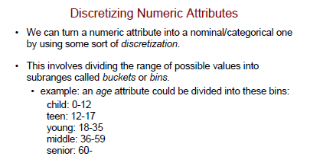
Transformation by Discretization
Some Algorithms require nominal/ discrete attributes

Slide 67
Discretization methods
Unsupervised
  Independent of the class label
  Ex: Equal width binning, equal frequency binning
Supervised
  Dependent on the class label
  Ex: entropy based binning

Slide 68
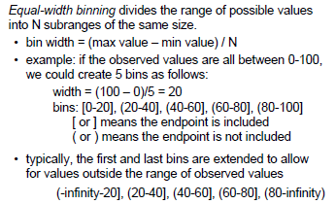
Unsupervised Discretization

Slide 69
Equal Width binning…
Advantages :
  Simple and easy to implement
  Produce a reasonable abstraction of data
Disadvantages :
  Unsupervised
  Where does N come from?
  If there are many occurrences of one range in the data set, it would be useless for the data mining task.

Slide 70
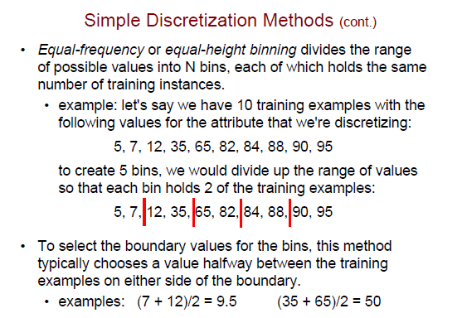

Slide 71
Entropy Based Discretization- Supervised
Uses the class info present in the data
Entropy(info content) is calculated based on the class label
Tries to find the best split so that bins are as pure as possible.
Pure bin : majority of the values in a bin should correspond to the same class.
Purity of a bin is measured using its entropy
Entropy
  Zero – perfectly pure bin
  Max (1) – impure – equal class distribution

Slide 72
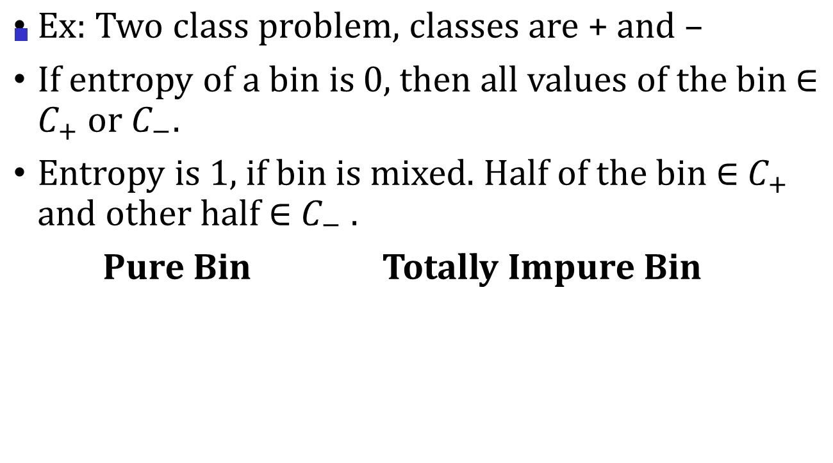
Entropy Based Discretization- Supervised…
15 7
+ + +
6 13 7
+ - - +

Slide 73
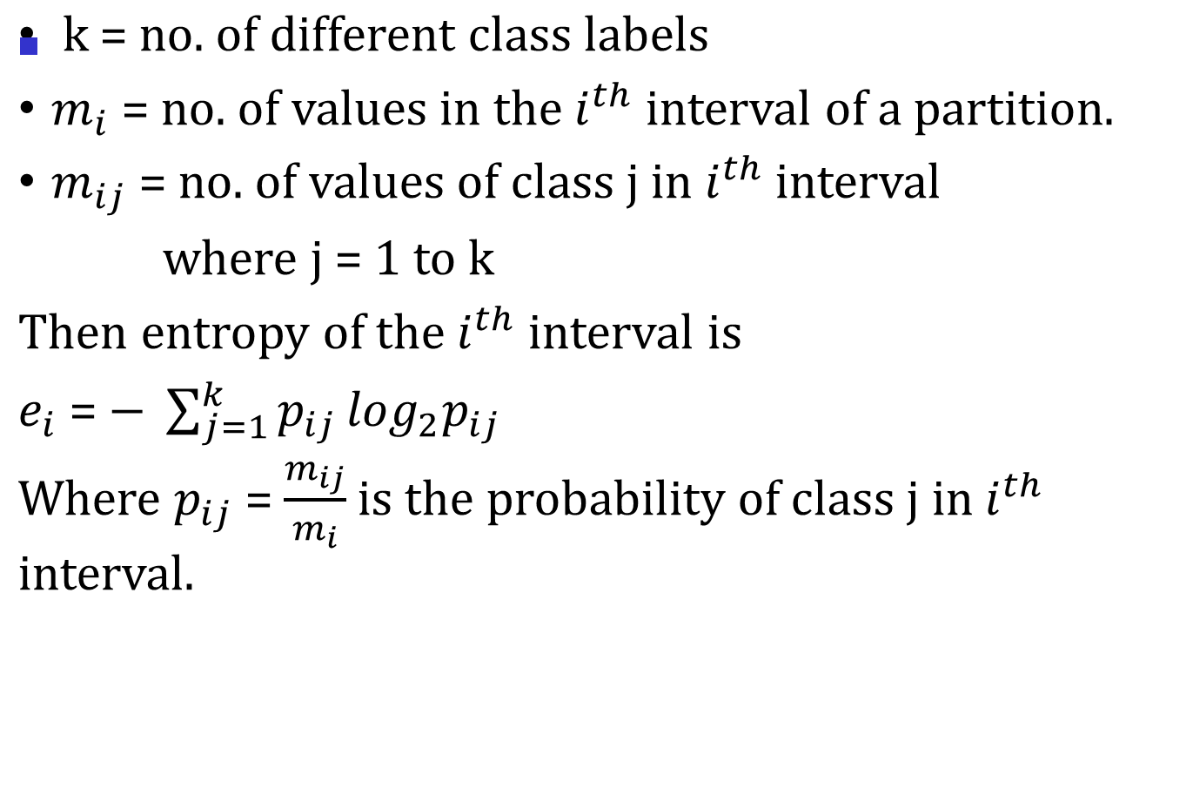
Entropy

Slide 74
Procedure…
Sort the attb values to be discretized, S
Bisect the initial values so that the resulting two intervals have minimum entropy.
  Consider each value T as a possible split point Where T = midpoint of each consecutive attb values.
  Compute the information gain before and after choosing T as a split point.
  Gain = E(S) – E(T,S)
  Select the best T which gives the highest info gain as the optimum split.

Slide 75
3. Repeat step 2 with another interval (highest entropy) until a user specified no. of intervals is reached or some stopping criterion is met.

Slide 76
Normalization
Scale attribute values to fall within a small-specified range.
  Min-max
  Z-score
  Decimal scaling
Ex : kNN classifiers
Customer | Age | Income | Purchased Product?
1 | 45 | 75K | Book
2 | 39 | 100K | TV
3 | 39 | 150K | DVD
4 | 58 | 51K | ???

Slide 77
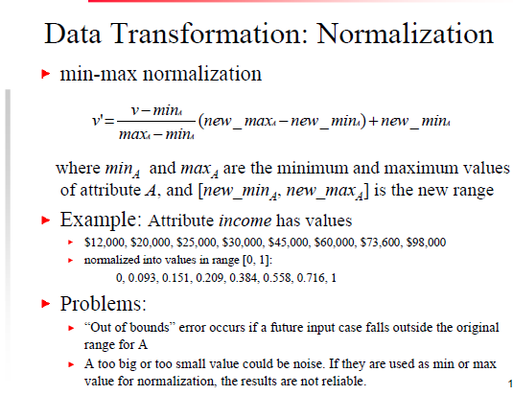

Slide 78
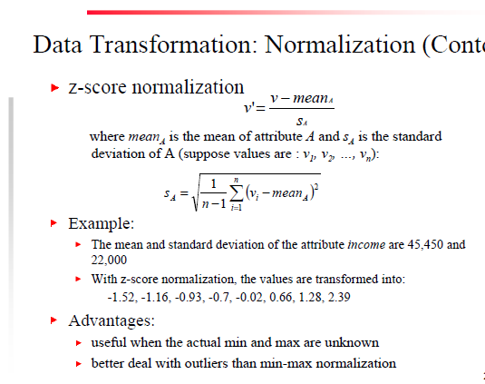

Slide 79
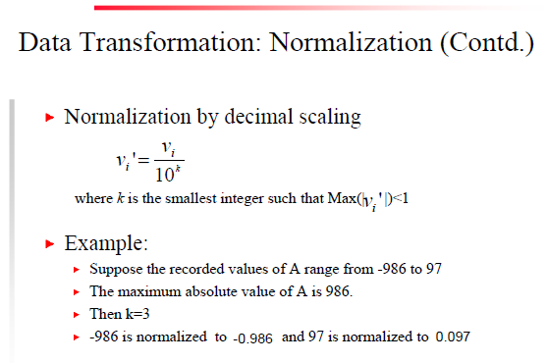
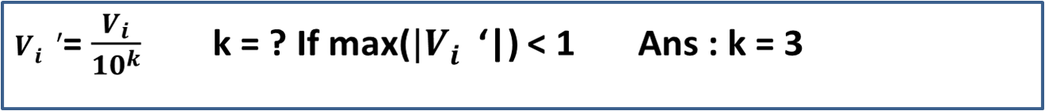

Slide 80
Binarization
Transforming a continuous or discrete attribute into one or more binary attribute
Why?
  ARM can be done only on binarized data.
  But i/p data set may have numeric/discrete attributes
Binarizing a categorical data:-
If the categorical attb has m distinct values,
assign a unique integer from 0 to m-1 to each value.
Represent each integer using unique bit combinations

Slide 81
Binarization….
Ex :
Categorical value | Integer Value | X1 | X2 | X3
Awful | 0 | 0 | 0 | 0
Poor | 1 | 0 | 0 | 1
Ok | 2 | 0 | 1 | 0
Good | 3 | 0 | 1 | 1
great | 4 | 1 | 0 | 0

Slide 82
Summary
Data quality: accuracy, completeness, consistency, timeliness, believability, interpretability
Data cleaning: e.g. missing/noisy values, outliers
Data integration from multiple sources:
  Entity identification problem
  Remove redundancies
  Detect inconsistencies
Data reduction
  Dimensionality reduction
  Numerosity reduction
  Data compression
Data transformation and data discretization
  Normalization
  Concept hierarchy generation

Slide 83
References
D. P. Ballou and G. K. Tayi. Enhancing data quality in data warehouse environments. Comm. of ACM, 42:73-78, 1999
A. Bruce, D. Donoho, and H.-Y. Gao. Wavelet analysis. IEEE Spectrum, Oct 1996
T. Dasu and T. Johnson. Exploratory Data Mining and Data Cleaning. John Wiley, 2003
J. Devore and R. Peck. Statistics: The Exploration and Analysis of Data. Duxbury Press, 1997.
H. Galhardas, D. Florescu, D. Shasha, E. Simon, and C.-A. Saita. Declarative data cleaning: Language, model, and algorithms. VLDB'01
M. Hua and J. Pei. Cleaning disguised missing data: A heuristic approach. KDD'07
H. V. Jagadish, et al., Special Issue on Data Reduction Techniques. Bulletin of the Technical Committee on Data Engineering, 20(4), Dec. 1997
H. Liu and H. Motoda (eds.). Feature Extraction, Construction, and Selection: A Data Mining Perspective. Kluwer Academic, 1998
J. E. Olson. Data Quality: The Accuracy Dimension. Morgan Kaufmann, 2003
D. Pyle. Data Preparation for Data Mining. Morgan Kaufmann, 1999
V. Raman and J. Hellerstein. Potters Wheel: An Interactive Framework for Data Cleaning and Transformation, VLDB’2001
T. Redman. Data Quality: The Field Guide. Digital Press (Elsevier), 2001
R. Wang, V. Storey, and C. Firth. A framework for analysis of data quality research. IEEE Trans. Knowledge and Data Engineering, 7:623-640, 1995

